Slide 1
Devops Pipeline
BY
SUNIL NARASIMHAMURTHY
SOHAN KUNKERKAR
AJAY CHANDRA PENDYALA
PRANAV FIRAKE
UNDER THE GUIDANCE OF :
DR. PARNIN

Slide 2
Devops Pipeline
Sr | Milestones | Checkbox.io | iTrust
Mile 1 | Configuration management | Configuring the environments | Configuring the environments
Mile 2 | Build, Test & Analysis | Jenkins build server Code analysis | Jenkins build server Test coverage Test fuzzer Useless test detector
Mile 3 | Deploy | Deployment on AWS EC2 instance Load balancer Canary Release Feature Flag | Deployment on EC2 instance Rolling updates

Slide 3
Sr | Milestones | Checkbox.io | iTrust
Mile 1 | Configuration management | Configuring the environments | Configuring the environments

Slide 4






Checkbox.io
Configuration Environment
Playbook
npm
Ansible Server
Nginx web server
Node.js
Code repo
Ansible Node
Github

Slide 5
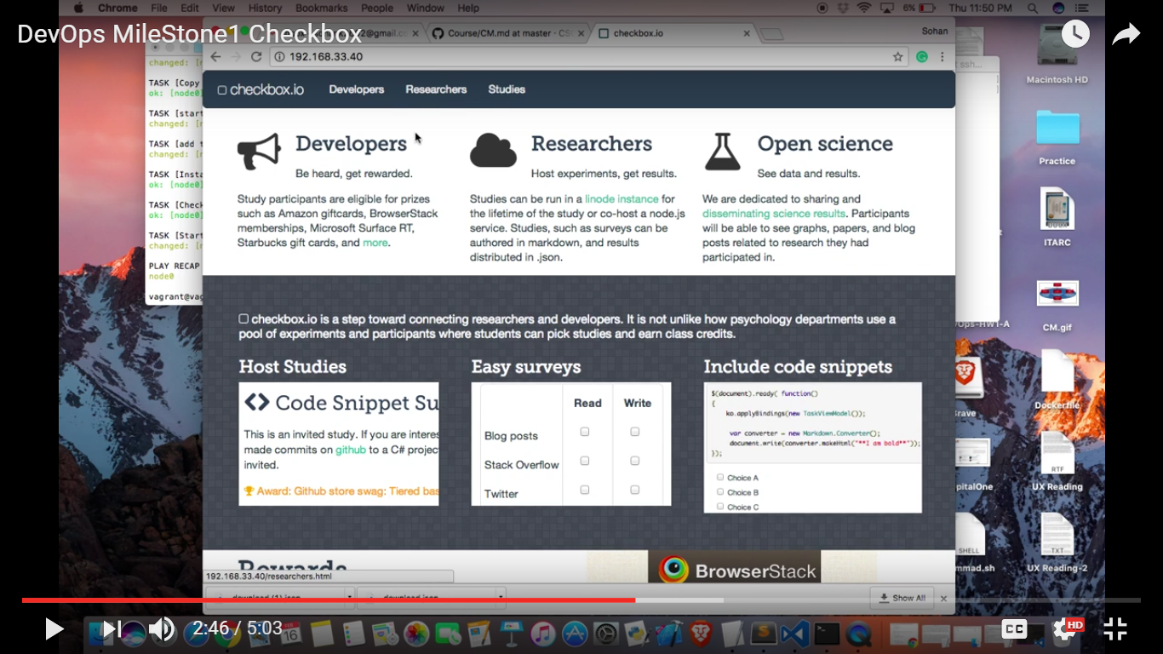

Slide 6
Sr | Milestones | Checkbox.io | iTrust
Mile 1 | Configuration management | Configuring the environments | Configuring the environments

Slide 7




iTrust
Configuration Environment
Playbook
Maven
Ansible Server
Tomcat server
Java
Code repo
Ansible Node
Github

Slide 8
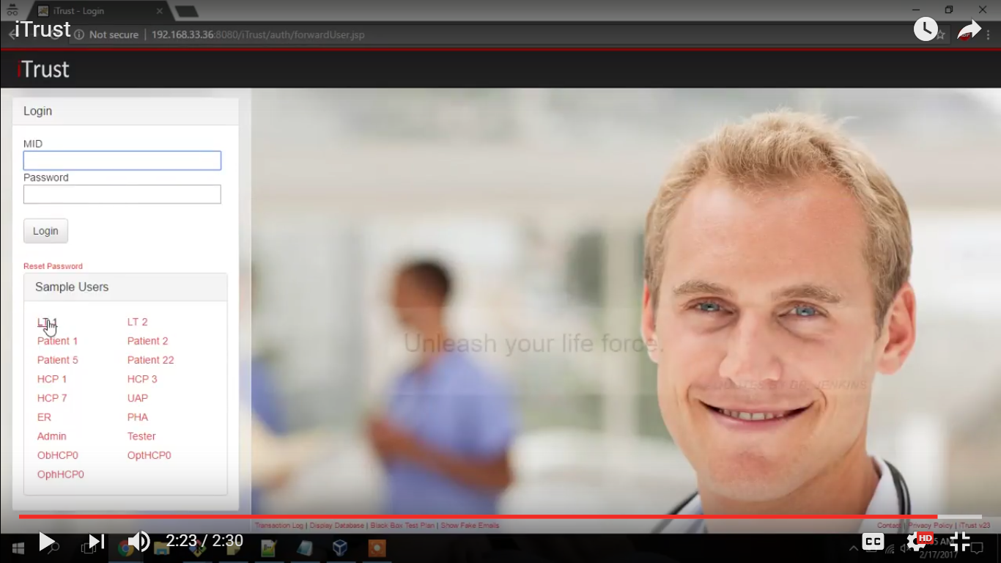

Slide 9
Sr | Milestones | Checkbox.io | iTrust
Mile 2 | Build, Test & Analysis | Jenkins build server Code analysis | Jenkins build server Test coverage Test fuzzer Useless test detector

Slide 10
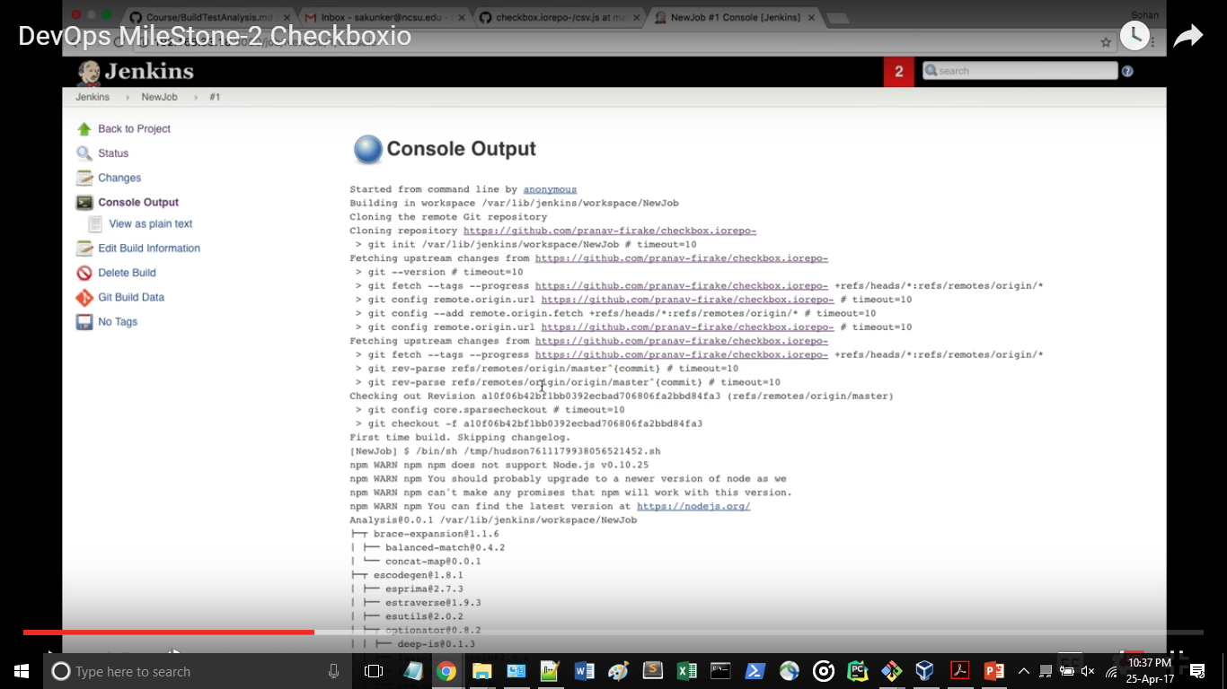
Checkbox.io - Jenkins Build Server

Slide 11
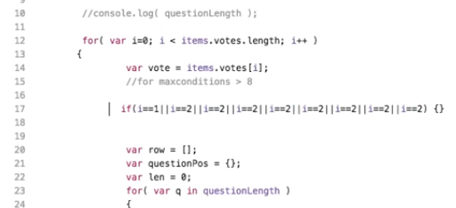
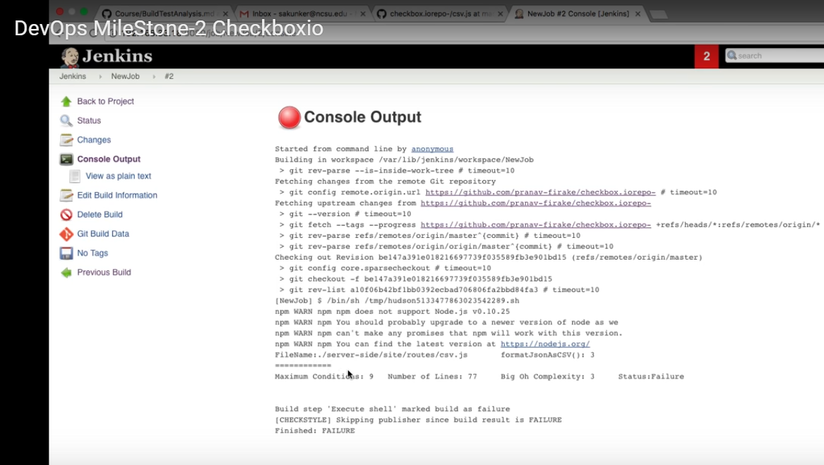
Checkbox.io - CODE ANALYSIS

Slide 12
Sr | Milestones | Checkbox.io | iTrust
Mile 2 | Build, Test & Analysis | Jenkins build server Code analysis | Jenkins build server Test coverage Test fuzzer Useless test detector

Slide 13
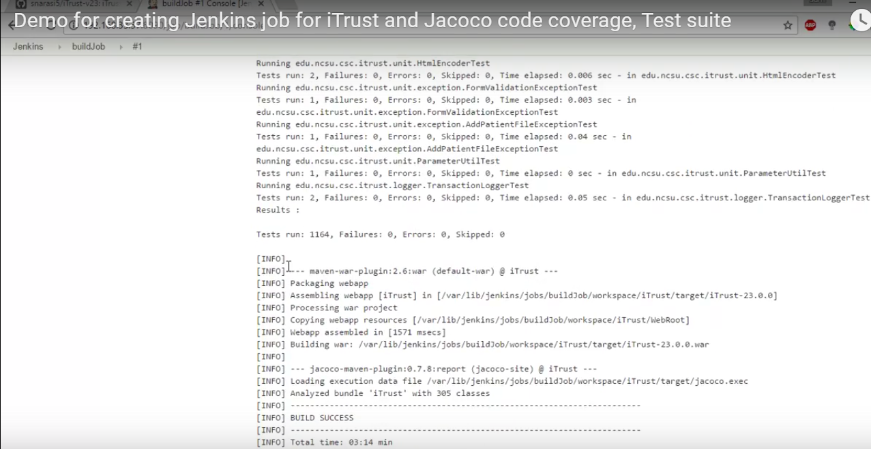
iTrust - Jenkins Build Server

Slide 14
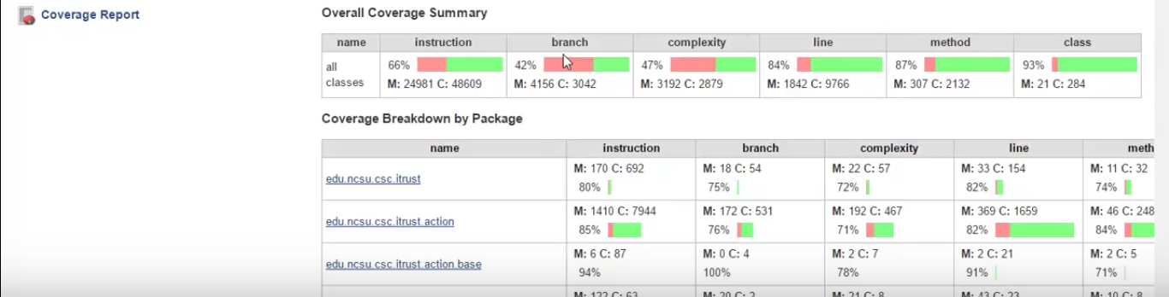

iTrust - TEST COVERAGE

Slide 15






iTrust - Test Fuzzer
YES
100 th ???
NO
Start
Build
Fuzz it (Make Random Changes)

Slide 16
Sr | Milestones | Checkbox.io | iTrust
Mile 3 | Deploy | Deployment on Cloud Load balancer Canary Release Feature Flag | Deployment on Cloud Rolling updates

Slide 17
Checkbox.io - Deployment on AWS

Slide 18
Checkbox.io - LOAD BALANCER

Slide 19
Checkbox.io - CANARY RELEASE

Slide 20
Checkbox.io - FEATURE FLAG

Slide 21
Sr | Milestones | Checkbox.io | iTrust
Mile 3 | Deploy | Deployment on AWS EC2 instance Load balancer Canary Release Feature Flag | Deployment on EC2 instance Rolling updates

Slide 22
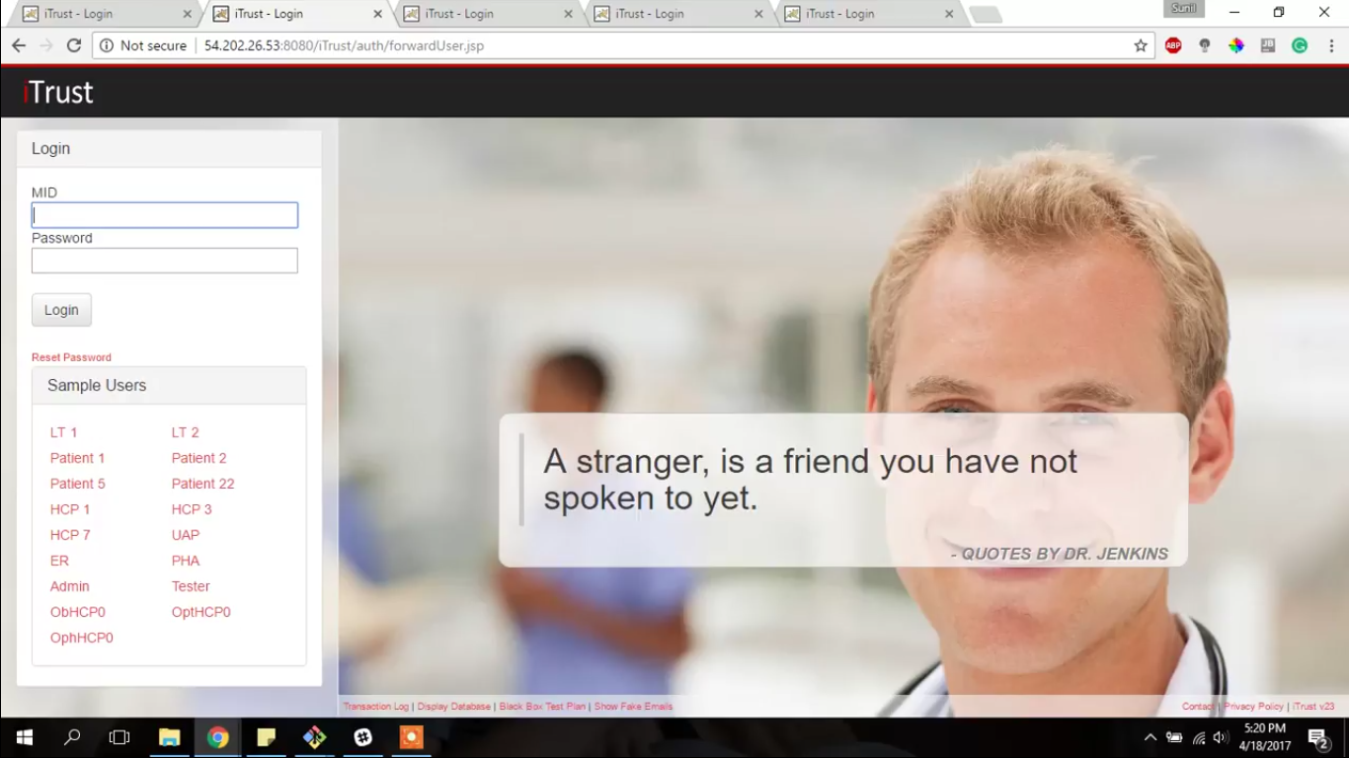
itrust - Deployment on AWS

Slide 23
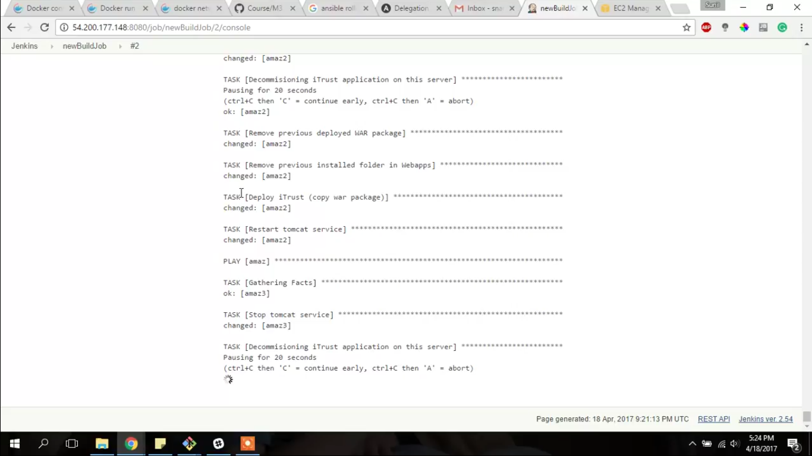
itrust - ROLLING UPDATES

Slide 24
Sr | Milestones | Checkbox.io
SPECIAL | Special Milestone | Clean up monkey Gremlin Monkey

Slide 25

CLean UP Monkey
Problem:
In multiserver environment, there can be the scenario when the log files or the files which are important but they do not contribute to execution of the application.
Solution:
Clean up monkey will track the log files and if their size gets greater than limit then it copies those files to backup server and deletes them from running server

Slide 26

CLean UP Monkey
Log files
Log files
Log files
Flooding
Log files
Production server
Back up server

Slide 27

Gremlin Monkey
Problem:
Web application to be robust, it must be tested for varied user inputs. This includes random clicks, unexpected user behaviour
Solution:
Gremlin monkey provides the functionality to perform random clicks and navigations on application and one can check console.log for inconsistencies

Slide 28
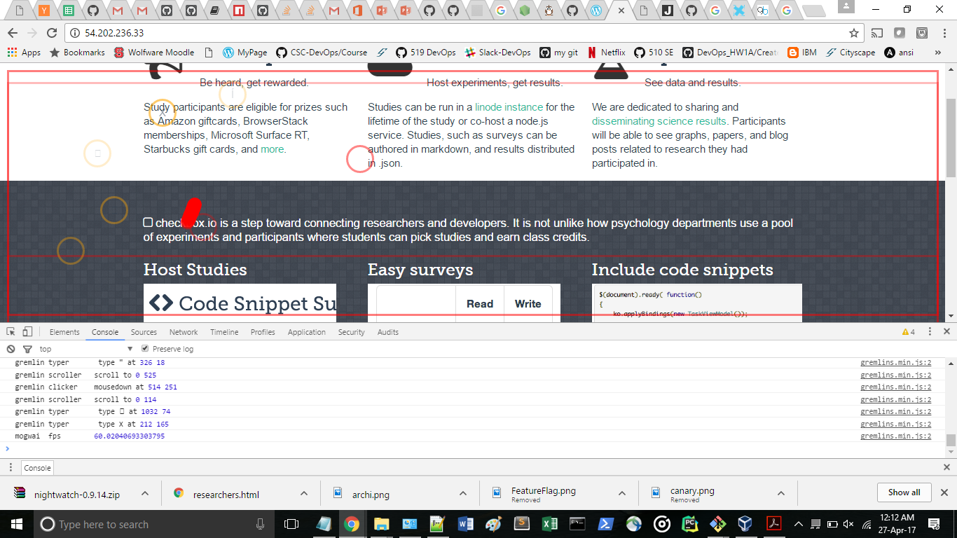
Gremlin Monkey

Slide 29

Thank You

